Slide 1


Training and Placement Cell at LBEF
Bishal Lamichhane-NP069450
Urmila shrestha-NP069491
Maulik shahi thakuri-NP069464

Slide 2
Introduction
Title: Training and Placement Cell at LBEF
Brief overview of TPC's establishment and purpose
Mention of internship programs, training opportunities, career guidance, and sessions

Slide 3
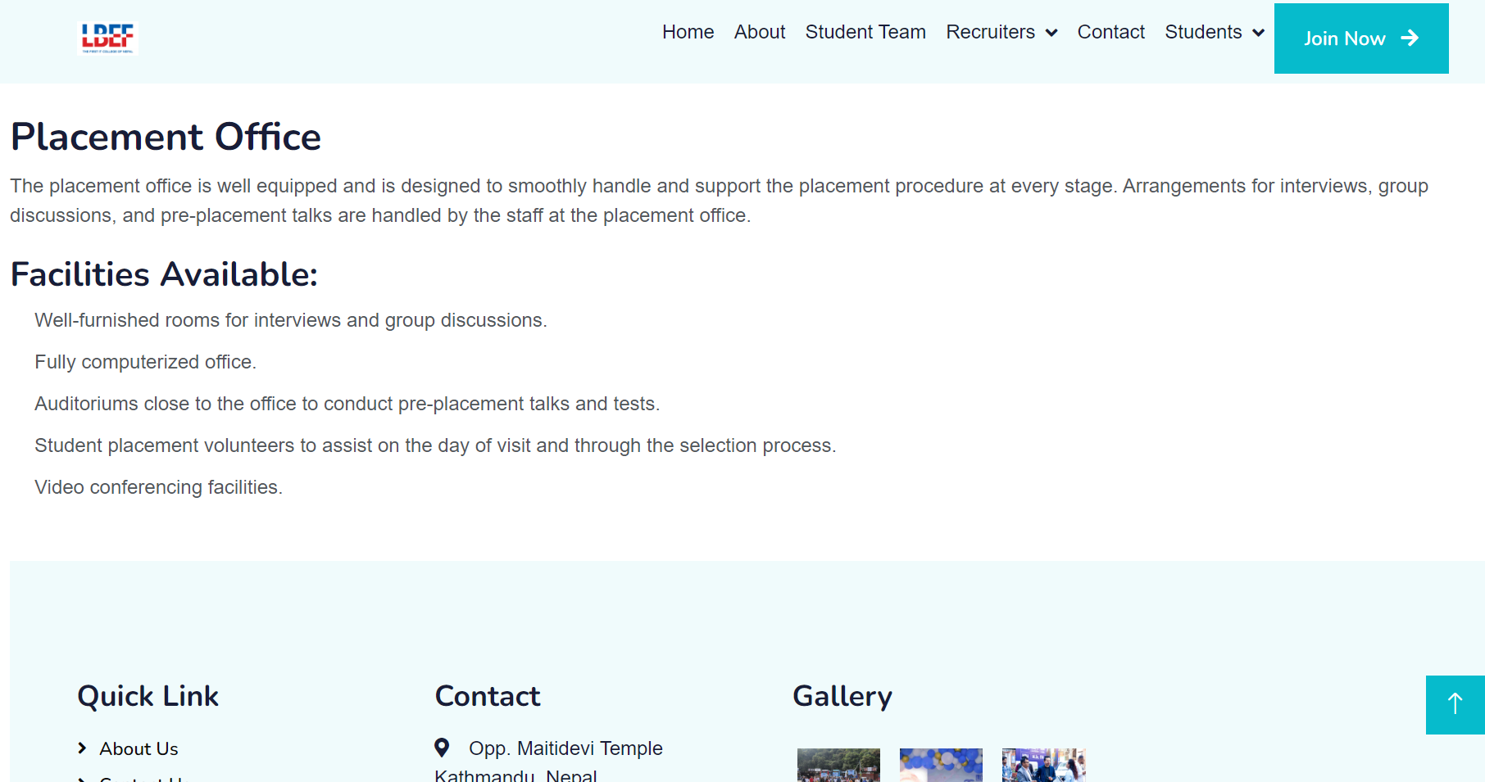

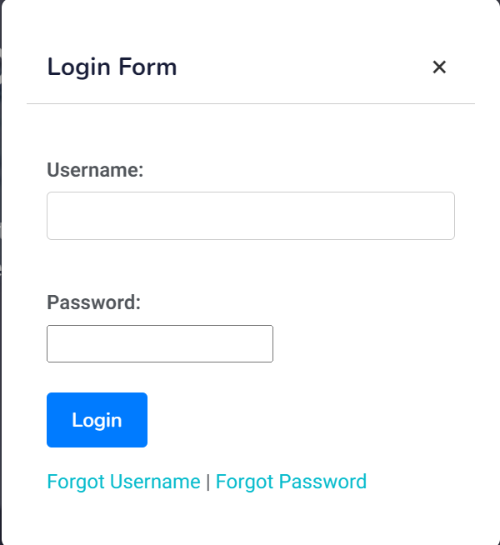
Picture

Slide 4
Objectives
Provide accurate college information to stakeholders
Highlight campus events, seminars, and activities
Offer comprehensive knowledge about facilities and environment
Improve communication and support systems
Regularly share news and updates

Slide 5
Target Audience
Current & Prospective Students
Faculty
Alumni
Corporate Partners
Community Partners

Slide 6
Project Schedule
Overview of TPC's project schedule stages:
Planning
Information Gathering
Design
Testing
Implementation

Slide 7
Summary of Web Pages
Brief description of key web pages:
Home Page: Introduction and navigation
About Page: College background and values
Student Team Page: Student involvement and profiles
Facilities Page: Campus resources and infrastructure
TPC Calendar Page: Upcoming events and programs
Past Recruiter Page: Partnerships and success stories

Slide 8
Problems & Evaluation
Identification of potential challenges:
Technical issues, content updates, user engagement
Brief mention of evaluation methods:
Feedback forms, user analytics, stakeholder surveys

Slide 9
Conclusion
Recap of key points:
TPC's role in enhancing student opportunities
Website's significance in achieving objectives
Closing statement emphasizing TPC's commitment to student success

Slide 10


